Slide 1
Secondary Storage
Professor Dr. Md. Ismail Jabiullah
Professor
Department of CSE
Daffodil International University

Slide 2
Learning Objectives
In this lecture you will learn about:
Secondary storage devices and their need
Classification of commonly used secondary storage devices
Difference between sequential and direct access storage devices
Basic principles of operation, types, and uses of popular secondary storage devices such as magnetic tape, magnetic disk, and optical disk
Commonly used mass storage devices
Introduction to other related concepts such as RAID, Jukebox, storage hierarchy, etc.

Slide 3
Limitations of Primary Storage
Limited capacity because the cost per bit of storage is high
Volatile - data stored in it is lost when the electric power is turned off or interrupted

Slide 4
Secondary Storage
Used in a computer system to overcome the limitations of primary storage
Has virtually unlimited capacity because the cost per bit of storage is very low
Has an operating speed far slower than that of the primary storage
Used to store large volumes of data on a permanent basis
Also known as auxiliary memory

Slide 5
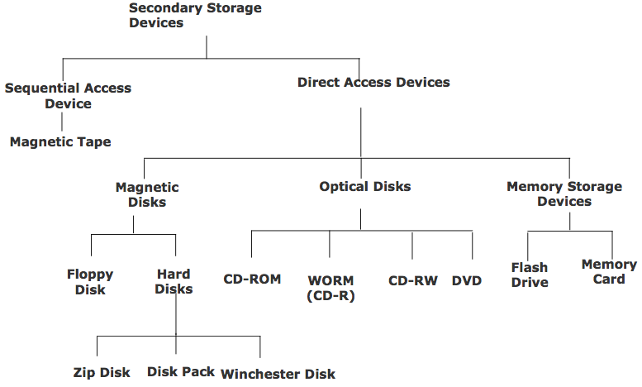
Classification of Commonly Used Secondary Storage Devices

Slide 6
Sequential-access Storage Devices
Arrival at the desired storage location may be preceded by sequencing through other locations
Data can only be retrieved in the same sequence in which it is stored
Access time varies according to the storage location of the information being accessed
Suitable for sequential processing applications where most, if not all, of the data records need to be processed one after another
Magnetic tape is a typical example of such a storage device

Slide 7
Direct-access Storage Devices
Devices where any storage location may be selected and accessed at random
Permits access to individual information in a more direct or immediate manner
Approximately equal access time is required for accessing information from any storage location
Suitable for direct processing applications such as on-line ticket booking systems, on-line banking systems
Magnetic, optical, and magneto-optical disks are typical examples of such a storage device

Slide 8
Magnetic Tape Basics
Commonly used sequential-access secondary storage device
Physically, the tape medium is a plastic ribbon, which is usually ½ inch or ¼ inch wide and 50 to 2400 feet long
Plastic ribbon is coated with a magnetizable recording material such as iron-oxide or chromium dioxide
Data are recorded on the tape in the form of tiny invisible magnetized and non-magnetized spots (representing 1s and 0s) on its coated surface
Tape ribbon is stored in reels or a small cartridge or cassette

Slide 9
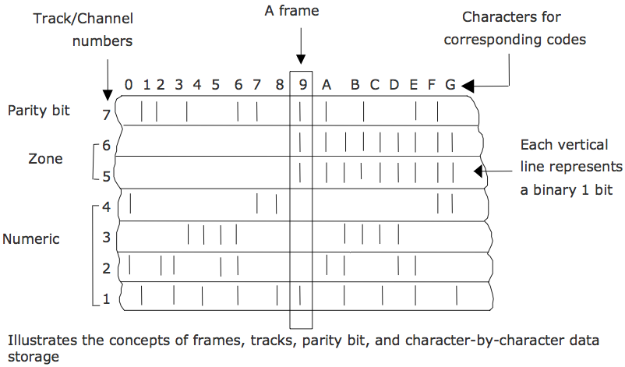
Magnetic Tape - Storage Organization (Example 1)

Slide 10
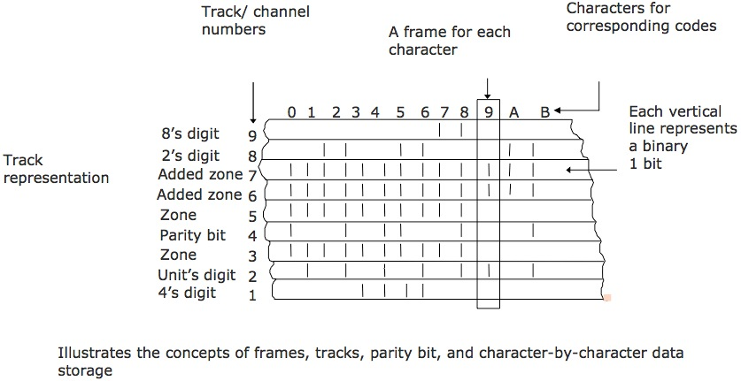
Magnetic Tape - Storage Organization (Example 2)

Slide 11
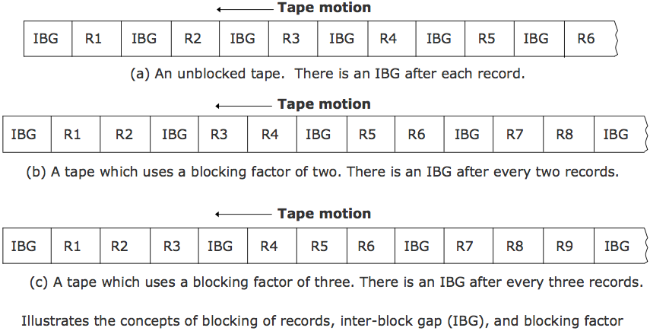
Magnetic Tape - Storage Organization (Example 3)

Slide 12
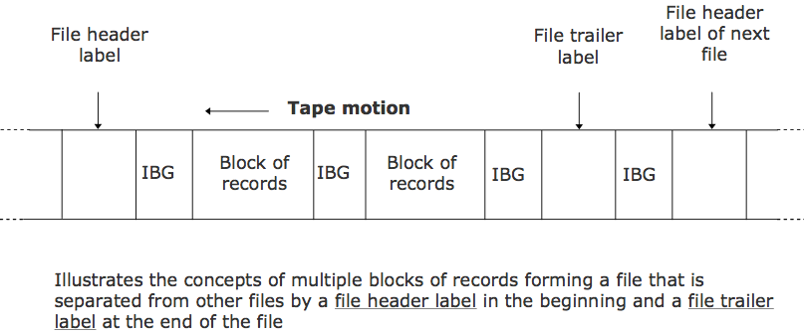
Magnetic Tape - Storage Organization (Example 4)

Slide 13
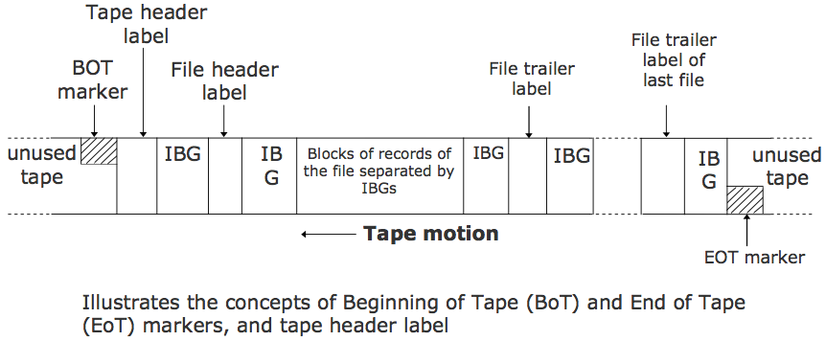
Magnetic Tape-Storage Organization (Example 5)

Slide 14
Magnetic Tape Storage Capacity
Storage capacity of a tape = Data recording density x Length
Data recording density is the amount of data that can be stored on a given length of tape. It is measured in bytes per inch (bpi)
Tape density varies from 800 bpi in older systems to 77,000 bpi in some of the modern systems
Actual storage capacity of a tape may be anywhere from 35% to 70% of its total storage capacity, depending on the storage organization used

Slide 15
Magnetic Tape – Data Transfer Rate
Refers to characters/second that can be transmitted to the memory from the tape
Transfer rate measurement unit is bytes/second (bps)
Value depends on the data recording density and the speed with which the tape travels under the read/write head
A typical value of data transfer rate is 7.7 MB/second

Slide 16
Magnetic Tape – Tape Drive
Used for writing/reading of data to/from a magnetic tape ribbon
Different for tape reels, cartridges, and cassettes
Has read/write heads for reading/writing of data on tape
A magnetic tape reel/cartridge/cassette has to be first loaded on a tape drive for reading/writing of data on it
When processing is complete, the tape is removed from the tape drive for off-line storage

Slide 17
Magnetic Tape – Tape Controller
Tape drive is connected to and controlled by a tape controller that interprets the commands for operating the tape drive
A typical set of commands supported by a tape controller are:
Read reads one block of data
Write writes one block of data
Write tape header label used to update the contents of tape header label
Erase tape erases the data recorded on a tape
Back space one block rewinds the tape to the beginning of previous block

Slide 18
Types of Magnetic Tape
½-inch tape reel
½-inch tape cartridge
¼-inch streamer tape
4-mm digital audio tape (DAT)

Slide 19
Half-inch Tape Reel
Uses ½ inch wide tape ribbon stored on a tape reel
Uses parallel representation method of storing data, in which data are read/written a byte at a time
Uses a read/write head assembly that has one read/write head for each track
Commonly used as archival storage for off-line storage of data and for exchange of data and programs between organizations
Fast getting replaced by tape cartridge, streamer tape, and digital audio tape they are more compact, cheaper and easier to handle

Slide 20
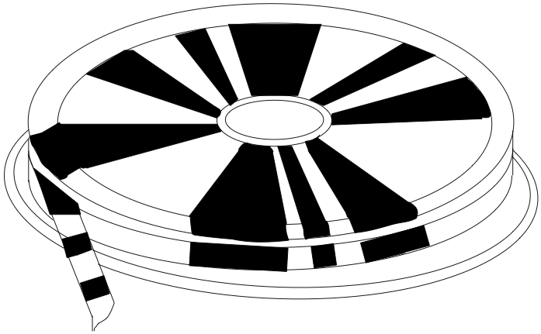
Half-inch Tape Reel

Slide 21
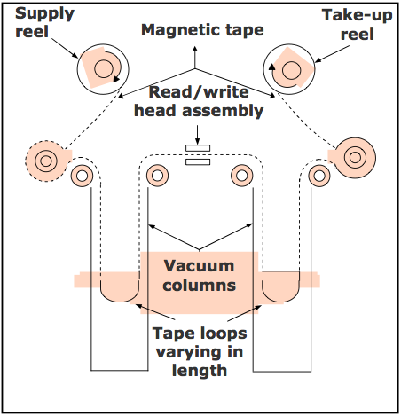
Tape Drive of Half-inch Tape Reel

Slide 22
Half-inch Tape Cartridge
Uses ½ inch wide tape ribbon sealed in a cartridge
Has 36 tracks, as opposed to 9 tracks for most half-inch tape reels
Stores data using parallel representation. Hence, 4 bytes of data are stored across the width of the tape. This enables more bytes of data to be stored on the same length of tape
Tape drive reads/writes on the top half of the tape in one direction and on the bottom half in the other direction

Slide 23
Half-inch Tape Cartridge

Slide 24
Quarter-inch Streamer Tape
Uses ¼ inch wide tape ribbon sealed in a cartridge
Uses serial representation of data recording (data bits are aligned in a row one after another in tracks)
Can have from 4 to 30 tracks, depending on the tape drive
Depending on the tape drive, the read/write head reads/writes data on one/two/four tracks at a time
Eliminates the need for the start/stop operation of traditional tape drives
Can read/write data more efficiently than the traditional tape drives because there is no start/stop mechanism
Make more efficient utilization of tape storage area than traditional tape drives because IBGs are not needed
The standard data formats used in these tapes is known as the QIC standard

Slide 25
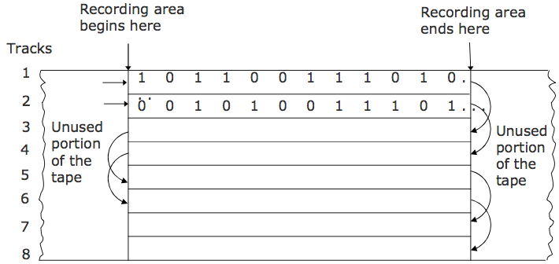
Quarter-inch Streamer Tape (Example)

Slide 26
4mm Digital Audio Tape (DAT)
Uses 4mm wide tape ribbon sealed in a cartridge
Has very high data recording density
Uses a tape drive that uses helical scan technique for data recording, in which two read heads and two write heads are built into a small wheel
DAT drives use a data recording format called Digital Data Storage (DDS), which provides three levels of error-correcting code
Typical capacity of DAT cartridges varies from 4 GB to 14 GB

Slide 27
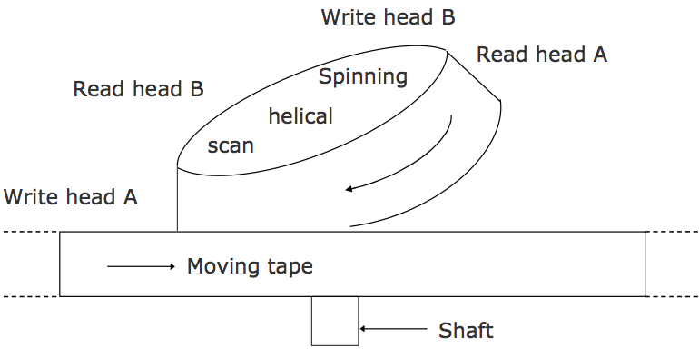
The Helical Scan Techniques Used in DAT Drives

Slide 28
Advantages of Magnetic Tapes
Storage capacity is virtually unlimited because as many tapes as required can be used for storing very large data sets
Cost per bit of storage is very low for magnetic tapes.
Tapes can be erased and reused many times
Tape reels and cartridges are compact and light in weight

Slide 29
Advantages of Magnetic Tapes
Easy to handle and store.
Very large amount of data can be stored in a small storage space
Compact size and light weight
Magnetic tape reels and cartridges are also easily portable from one place to another
Often used for transferring data and programs from one computer to another that are not linked together

Slide 30
Limitations of Magnetic Tapes
Due to their sequential access nature, they are not suitable for storage of those data that frequently require to be accessed randomly
Must be stored in a dust-free environment because specks of dust can cause tape-reading errors
Must be stored in an environment with properly controlled temperature and humidity levels
Tape ribbon may get twisted due to warping, resulting in loss of stored data
Should be properly labeled so that some useful data stored on a particular tape is not erased by mistake

Slide 31
Uses of Magnetic Tapes
For applications that are based on sequential data processing
Backing up of data for off-line storage
Archiving of infrequently used data
Transferring of data from one computer to another that are not linked together
As a distribution media for software by vendors

Slide 32
Magnetic Disk - Basics
Commonly used direct-access secondary storage device.
Physically, a magnetic disk is a thin, circular plate/platter made of metal or plastic that is usually coated on both sides with a magnetizable recording material such as iron-oxide
Data are recorded on the disk in the form of tiny invisible magnetized and non-magnetized spots (representing 1s and 0s) on the coated surfaces of the disk
The disk is stored in a specially designed protective envelope or cartridge, or several of them are stacked together in a sealed, contamination-free container

Slide 33
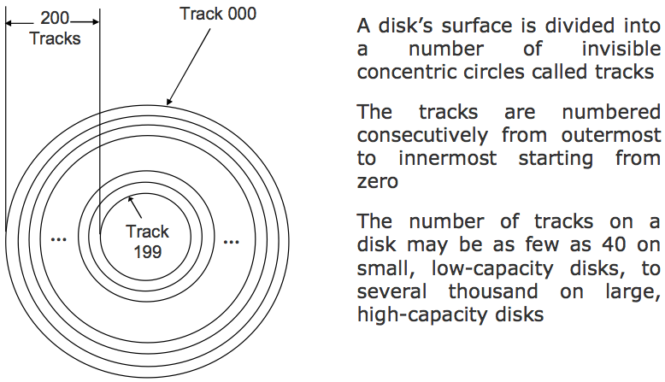
Magnetic Disk – Storage Organization Illustrates the Concept of Tracks

Slide 34
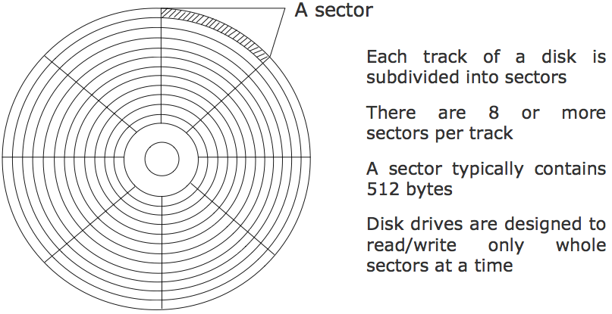
Magnetic Disk – Storage Organization Illustrates the Concept of Sectors

Slide 35
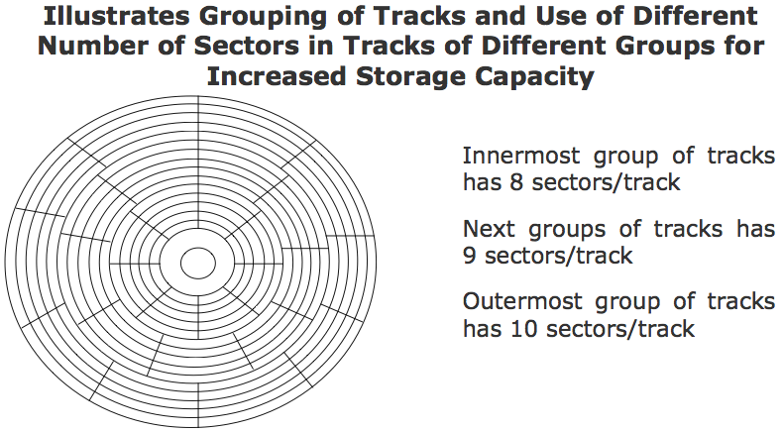
Magnetic Disk – Storage Organization

Slide 36
Magnetic Disk – Disk Address or Address of a Record on a Disk
Disk address represents the physical location of the record on the disk
It is comprised of the sector number, track number, and surface number (when double-sided disks are used)
This scheme is called the CHS addressing or Cylinder-Head-Sector addressing. The same is also referred to as disk geometry

Slide 37
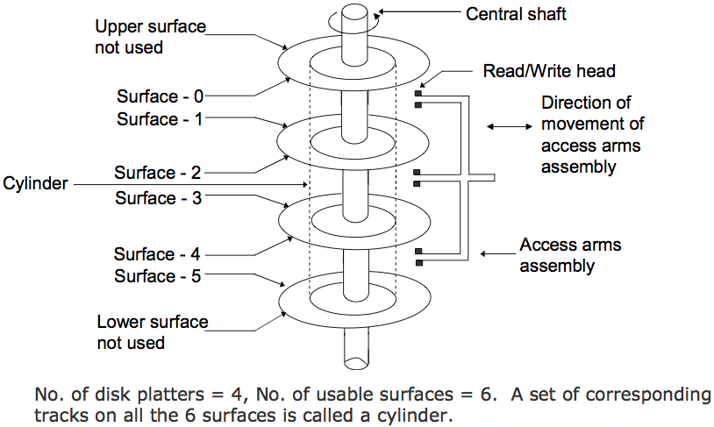
Magnetic Disk – Storage Organization (Illustrates the Concept of Cylinder)

Slide 38
Magnetic Disk – Storage Capacity
Storage capacity of a disk system =
Number of recording surfaces
× Number of tracks per surface
× Number of sectors per track
× Number of bytes per sector

Slide 39
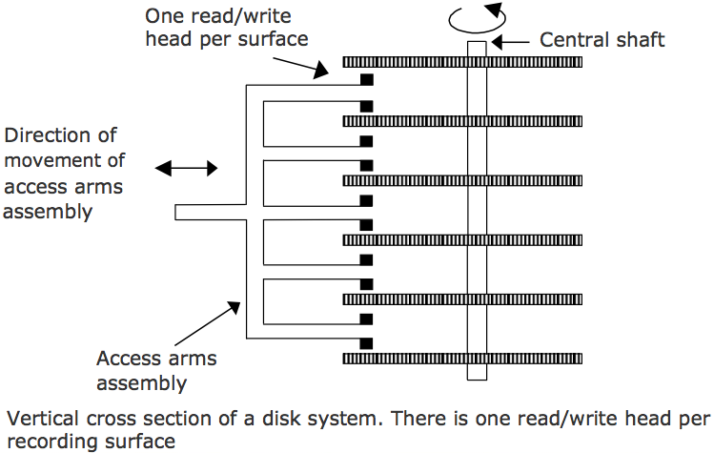
Magnetic Disk Pack – Access Mechanism

Slide 40
Magnetic Disk – Access Time
Disk access time is the interval between the instant a computer makes a request for transfer of data from a disk system to the primary storage and the instant this operation is completed
Disk access time depends on the following three parameters:
Seek Time: It is the time required to position the read/write head over the desired track, as soon as a read/write command is received by the disk unit
Latency: It is the time required to spin the desired sector under the read/write head, once the read/write head is positioned on the desired track
Transfer Rate: It is the rate at which data are read/written to the disk, once the read/write head is positioned over the desired sector
As the transfer rate is negligible as compared to seek time and latency, Average access time = Average seek time + Average latency

Slide 41
Disk Formatting
Process of preparing a new disk by the computer system in which the disk is to be used.
For this, a new (unformatted) disk is inserted in the disk drive of the computer system and the disk formatting command is initiated
Low-level disk formatting
Disk drive’s read/write head lays down a magnetic pattern on the disk’s surface
Enables the disk drive to organize and store the data in the data organization defined for the disk drive of the computer

Slide 42
Disk Formatting
OS-level disk formatting
Creates the File Allocation Table (FAT) that is a table with the sector and track locations of data
Leaves sufficient space for FAT to grow
Scans and marks bad sectors
One of the basic tasks handled by the computer’s operating system
Enables the use of disks manufactured by third party vendors into one’s own computer system

Slide 43
Magnetic Disk – Disk Drive
Unit used for reading/writing of data on/from a magnetic disk
Contains all the mechanical, electrical and electronic components for holding one or more disks and for reading or writing of information on to it
Although disk drives vary greatly in their shape, size and disk formatting pattern, they can be broadly classified into two types:
Those with interchangeable magnetic disks, which allow the loading and unloading of magnetic disks as and when they are needed for reading/writing of data on to them
Those with fixed magnetic disks, which come along with a set of permanently fixed disks. The disks are not removable from their disk drives

Slide 44
Magnetic Disk – Disk Controller
Disk drive is connected to and controlled by a disk controller, which interprets the commands for operating the disk drive
Typically supports only read and write commands, which need disk address (surface number, cylinder/track number, and sector number) as parameters
Connected to and controls more than one disk drive, in which case the disk drive number is also needed as a parameters of read and write commands

Slide 45
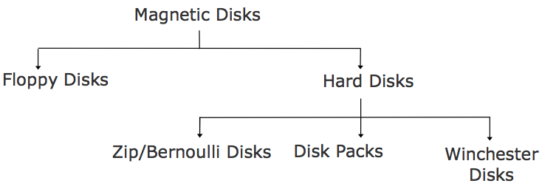
Types of Magnetic Disks

Slide 46
Floppy Disks
Round, flat piece of flexible plastic disks coated with magnetic oxide
So called because they are made of flexible plastic plates which can bend
Also known as floppies or diskettes
Plastic disk is encased in a square plastic or vinyl jacket cover that gives handling protection to the disk surface

Slide 47
Floppy Disks
The two types of floppy disks in use today are:
5¼-inch diskette, whose diameter is 5¼-inch. It is encased in a square, flexible vinyl jacket
3½-inch diskette, whose diameter is 3½-inch. It is encased in a square, hard plastic jacket
Most popular and inexpensive secondary storage medium used in small computers

Slide 48
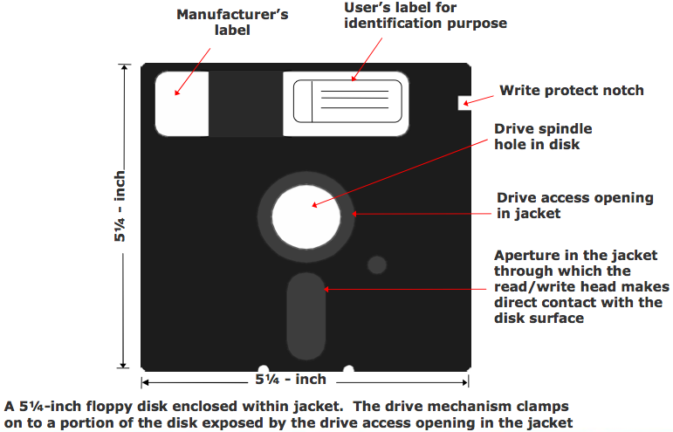
A 3½-inch Floppy Disk

Slide 49
A 3½-inch Floppy Disk

Slide 50
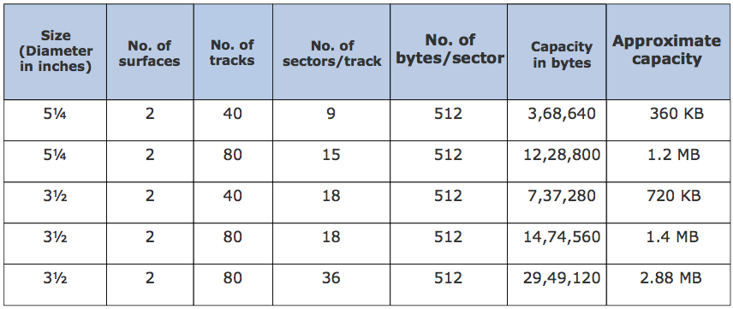
Storage Capacities of Various Types of Floppy Disks Size

Slide 51
Hard Disks
Round, flat piece of rigid metal (frequently aluminium) disks coated with magnetic oxide
Come in many sizes, ranging from 1 to 14-inch diameter.
Depending on how they are packaged, hard disks are of three types:
Zip/Bernoulli disks
Disk packs
Winchester disks
Primary on-line secondary storage device for most computer systems today

Slide 52
Zip/Bernoulli Disks
Uses a single hard disk platter encased in a plastic cartridge
Disk drives may be portable or fixed type
Fixed type is part of the computer system, permanently connected to it
Portable type can be carried to a computer system, connected to it for the duration of use, and then can be disconnected and taken away when the work is done
Zip disks can be easily inserted/removed from a zip drive just as we insert/remove floppy disks in a floppy disk drive

Slide 53
Disk Packs
Uses multiple (two or more) hard disk platters mounted on a single central shaft
Disk drives have a separate read/write head for each usable disk surface (the upper surface of the top-most disk and the lower surface of the bottom most disk is not used)
Disks are of removable/interchangeable type in the sense that they have to be mounted on the disk drive before they can be used, and can be removed and kept off-line when not in use

Slide 54
Winchester Disks
Uses multiple (two or more) hard disk platters mounted on a single central shaft
Hard disk platters and the disk drive are sealed together in a contamination-free container and cannot be separated from each other
For the same number of disks, Winchester disks have larger storage capacity than disk packs because:
All the surfaces of all disks are used for data recording
They employ much greater precision of data recording, resulting in greater data recording density
Named after the .30-30 Winchester rifle because the early Winchester disk systems had two 30-MB disks sealed together with the disk drive

Slide 55
Advantages of Magnetic Disks
More suitable than magnetic tapes for a wider range of applications because they support direct access of data
Random access property enables them to be used simultaneously by multiple users as a shared device. A tape is not suitable for such type of usage due to its sequential-access property
Suitable for both on-line and off-line storage of data

Slide 56
Advantages of Magnetic Disks
Except for the fixed type Winchester disks, the storage capacity of other magnetic disks is virtually unlimited as many disks can be used for storing very large data sets
Due to their low cost and high data recording densities, the cost per bit of storage is low for magnetic disks.
An additional cost benefit is that magnetic disks can be erased and reused many times
Floppy disks and zip disks are compact and light in weight. Hence they are easy to handle and store.

Slide 57
Advantages of Magnetic Disks
Very large amount of data can be stored in a small storage space
Due to their compact size and light weight, floppy disks and zip disks are also easily portable from one place to another
They are often used for transferring data and programs from one computer to another, which are not linked together
Any information desired from a disk storage can be accessed in a few milliseconds because it is a direct access storage device

Slide 58
Advantages of Magnetic Disks
Data transfer rate for a magnetic disk system is normally higher than a tape system
Magnetic disks are less vulnerable to data corruption due to careless handling or unfavorable temperature and humidity conditions than magnetic tapes

Slide 59
Limitations of Magnetic Disks
For Winchester disks, a disk crash or drive failure often results in loss of entire stored data. It is not easy to recover the lost data. Suitable backup procedures are suggested for data stored on Winchester disks
Some types of magnetic disks, such as disk packs and Winchester disks, are not so easily portable like magnetic tapes
On a cost-per-bit basis, the cost of magnetic disks is low, but the cost of magnetic tapes is even lower
For Winchester disks, a disk crash or drive failure often results in loss of entire stored data. It is not easy to recover the lost data. Suitable backup procedures are suggested for data stored on Winchester disks

Slide 60
Limitations of Magnetic Disks
Some types of magnetic disks, such as disk packs and Winchester disks, are not so easily portable like magnetic tapes
On a cost-per-bit basis, the cost of magnetic disks is low, but the cost of magnetic tapes is even lower
Must be stored in a dust-free environment
Floppy disks, zip disks and disk packs should be labeled properly to prevent erasure of useful data by mistake

Slide 61
Uses of Magnetic Disks
For applications that are based on random data processing
As a shared on-line secondary storage device. Winchester disks and disk packs are often used for this purpose
As a backup device for off-line storage of data. Floppy disks, zip disks, and disk packs are often used for this purpose

Slide 62
Uses of Magnetic Disks
Archiving of data not used frequently, but may be used once in a while. Floppy disks, zip disks, and disk packs are often used for this purpose
Transferring of data and programs from one computer to another that are not linked together. Floppy disks and zip disks are often used for this purpose
Distribution of software by vendors. Originally sold software or software updates are often distributed by vendors on floppy disks and zip disks

Slide 63
Optical Disk – Basics
Consists of a circular disk, which is coated with a thin metal or some other material that is highly reflective
Laser beam technology is used for recording/reading of data on the disk
Also known as laser disk / optical laser disk, due to the use of laser beam technology
Proved to be a promising random access medium for high capacity secondary storage because it can store extremely large amounts of data in a limited space

Slide 64
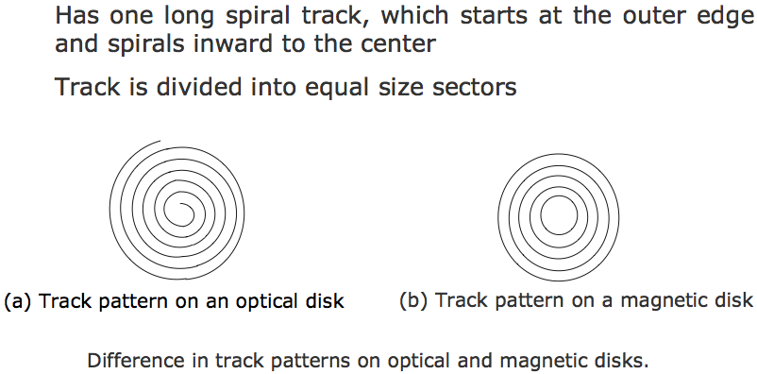
Optical Disk – Storage Organization

Slide 65
Optical Disk – Storage Capacity
Storage capacity of an optical disk
= Number of sectors × Number of bytes per sector
The most popular optical disk uses a disk of 5.25 inch diameter with storage capacity of around 650 Megabytes

Slide 66
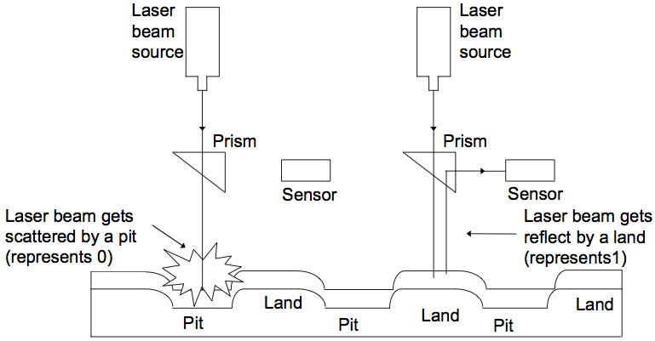
Optical Disk – Access Mechanism

Slide 67
Optical Disk – Access Time
With optical disks, each sector has the same length regardless of whether it is located near or away from the disk’s center
Rotation speed of the disk must vary inversely with the radius. Hence, optical disk drives use a constant linear velocity (CLV) encoding scheme
Leads to slower data access time (larger access time) for optical disks than magnetic disks
Access times for optical disks are typically in the range of 100 to 300 milliseconds and that of hard disks are in the range of 10 to 30 milliseconds

Slide 68
Optical Disk Drive
Uses laser beam technology for reading/writing of data
Has no mechanical read/write access arm
Uses a constant linear velocity (CLV) encoding scheme, in which the rotational speed of the disk varies inversely with the radius

Slide 69
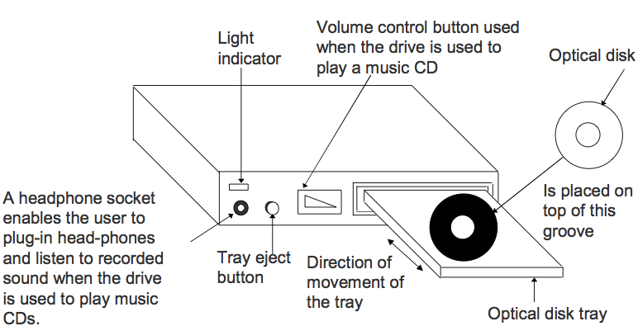
Optical Disk Drive

Slide 70
Types of Optical Disks
The types of optical disks in use today are:
CD-ROM
WORM Disk / CD-Recordable (CD-R)
CD-Read/Write (CD-RW)
Digital Video / Versatile Disk (DVD)

Slide 71
CD-ROM
Stands for Compact Disk-Read Only Memory
Packaged as shiny, silver color metal disk of 5¼ inch (12cm) diameter, having a storage capacity of about 650 Megabytes
Disks come pre-recorded and the information stored on them cannot be altered
Pre-stamped (pre-recorded) by their suppliers, by a process called mastering

Slide 72
CD-ROM
Provide an excellent medium to distribute large amounts of data in electronic dorm at low cost.
A single CD-ROM disk can hold a complete encyclopedia, or a dictionary, or a world atlas, or biographies of great people, etc
Used for distribution of electronic version of conference proceedings, journals, magazines, books, and multimedia applications such as video games
Used by software vendors for distribution of software to their customers

Slide 73
WORM Disk / CD-Recordable (CD-R)
Sessions after the first one are always additive and cannot alter the etched/burned information of earlier sessions
Information recorded on them can be read by any ordinary CD-ROM drive
They are used for data archiving and for making a permanent record of data. For example, many banks use them for storing their daily transactions

Slide 74
WORM Disk / CD-Recordable (CD-R)
Sessions after the first one are always additive and cannot alter the etched/burned information of earlier sessions
Information recorded on them can be read by any ordinary CD-ROM drive
They are used for data archiving and for making a permanent record of data. For example, many banks use them for storing their daily transactions

Slide 75
CD-Read/Write (CD-RW)
Same as CD-R and has same storage capacity
Allow users to create their own CD-ROM disks by using a CD-recordable (CD-R) drive that can be attached to a computer as a regular peripheral device
Data to be recorded can be written on its surface in multiple recording sessions
Made of metallic alloy layer whose chemical properties are changed during burn and erase
Can be erased and written afresh

Slide 76
Digital Video / Versatile Disk (DVD)
Looks same as CD-ROM but has capacity of 4.7 GB or 8.5 GB
Designed primarily to store and distribute movies
Can be used for storage of large data
Allows storage of video in 4:3 or 16:9 aspect-ratios in MPEG-2 video format using NTSC or PAL resolution
Audio is usually Dolby® Digital (AC-3) or Digital Theater System (DTS) and can be either monaural or 5.1 Surround Sound

Slide 77
Advantages of Optical Disks
The cost-per-bit of storage for optical disks is very low because of their low cost and enormous storage density.
The use of a single spiral track makes optical disks an ideal storage medium for reading large blocks of sequential data, such as music.
Optical disk drives do not have any mechanical read/write heads to rub against or crash into the disk surface. This makes optical disks a more reliable storage medium than magnetic tapes or magnetic disks.
Optical disks have a data storage life in excess of 30 years. This makes them a better storage medium for data archiving as compared to magnetic tapes or magnetic disks.

Slide 78
Advantages of Optical Disk
As data once stored on an optical disk becomes permanent, danger of stored data getting inadvertently erased/overwritten is removed
Due to their compact size and light weight, optical disks are easy to handle, store, and port from one place to another
Music CDs can be played on a computer having a CD-ROM drive along with a sound board and speakers. This allows computer systems to be also used as music systems

Slide 79
Limitations of Optical Disks
It is largely read-only (permanent) storage medium. Data once recorded, cannot be erased and hence the optical disks cannot be reused
The data access speed for optical disks is slower than magnetic disks
Optical disks require a complicated drive mechanism

Slide 80
Uses of Optical Disks
For distributing large amounts of data at low cost
For distribution of electronic version of conference proceedings, journals, magazines, books, product catalogs, etc
For distribution of new or upgraded versions of software products by software vendors
For distributing large amounts of data at low cost

Slide 81
Uses of Optical Disks
For distribution of electronic version of conference proceedings, journals, magazines, books, product catalogs, etc
For distribution of new or upgraded versions of software products by software vendors
For storage and distribution of a wide variety of multimedia applications
For archiving of data, which are not used frequently, but which may be used once in a while
WORM disks are often used by end-user companies to make permanent storage of their own proprietary information

Slide 82
Memory Storage Devices
Flash Drive (Pen Drive)
Relatively new secondary storage device based on flash memory, enabling easy transport of data from one computer to another
Compact device of the size of a pen, comes in various shapes and stylish designs and may have different added features
Plug-and-play device that simply plugs into a USB (Universal Serial Bus) port of a computer, treated as removable drive
Available storage capacities are 8MB, 16MB, 64MB, 128MB, 256MB, 512MB, 1GB, 2GB, 4GB, and 8GB

Slide 83
Memory Storage Devices
Memory Card (SD/MMC)
Similar to Flash Drive but in card shape
Plug-and-play device that simply plugs into a port of a computer, treated as removable drive
Useful in electronic devices like Camera, music player
Available storage capacities are 8MB, 16MB, 64MB, 128MB, 256MB, 512MB, 1GB, 2GB, 4GB, and 8GB

Slide 84
Mass Storage Devices
As the name implies, these are storage systems having several trillions of bytes of data storage capacity
They use multiple units of a storage media as a single secondary storage device
The three commonly used types are:
Disk array, which uses a set of magnetic disks
Automated tape library, which uses a set of magnetic tapes
CD-ROM Jukebox, which uses a set of CD-ROMs
They are relatively slow having average access times in seconds

Slide 85
Disk Array
Set of hard disks and hard disk drives with a controller mounted in a single box, forming a single large storage unit
It is commonly known as a RAID (Redundant Array of Inexpensive Disks)
As a secondary storage device, provides enhanced storage capacity, enhanced performance, and enhanced reliability
Enhanced storage capacity is achieved by using multiple disks
Enhanced performance is achieved by using parallel data transfer technique from multiple disks
Enhanced reliability is achieved by using techniques such as mirroring or striping
In mirroring, the system makes exact copies of files on two hard disks
In striping, a file is partitioned into smaller parts and different parts of the file are stored on different disks

Slide 86
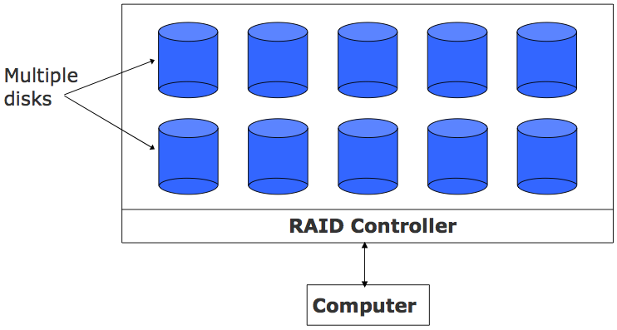
A RAID Unit

Slide 87
Automated Tape Library
Set of magnetic tapes and magnetic tape drives with a controller mounted in a single box, forming a single large storage unit
Large tape library can accommodate up to several hundred high capacity magnetic tapes bringing the storage capacity of the storage unit to several terabytes
Typically used for data archiving and as on-line data backup devices for automated backup in large computer centers

Slide 88
CD-ROM Jukebox
Set of CD-ROMs and CD-ROM drives with a controller mounted in a single box, forming a single large storage unit
Large CD-ROM jukebox can accommodate up to several hundred CD-ROM disks bringing the storage capacity of the storage unit to several terabytes
Used for archiving read-only data in such applications as on-line museums, on-line digital libraries, on-line encyclopedia, etc

Slide 89
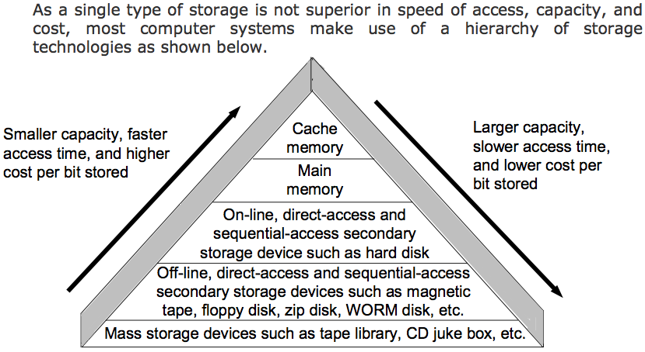
Storage Hierarchy

Slide 90
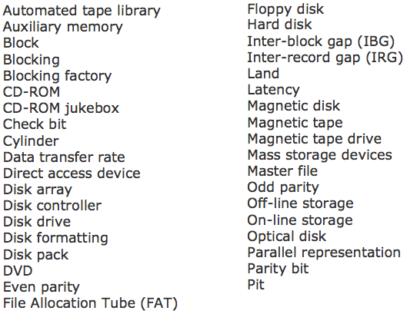
Key Words/Phrases

Slide 91
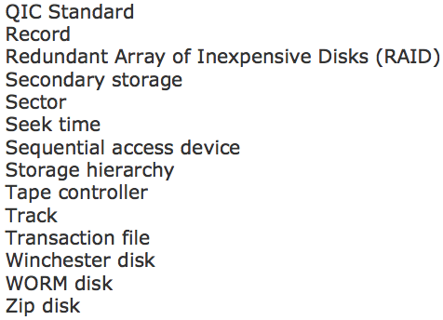
Key Words/Phrases

